Slide 1

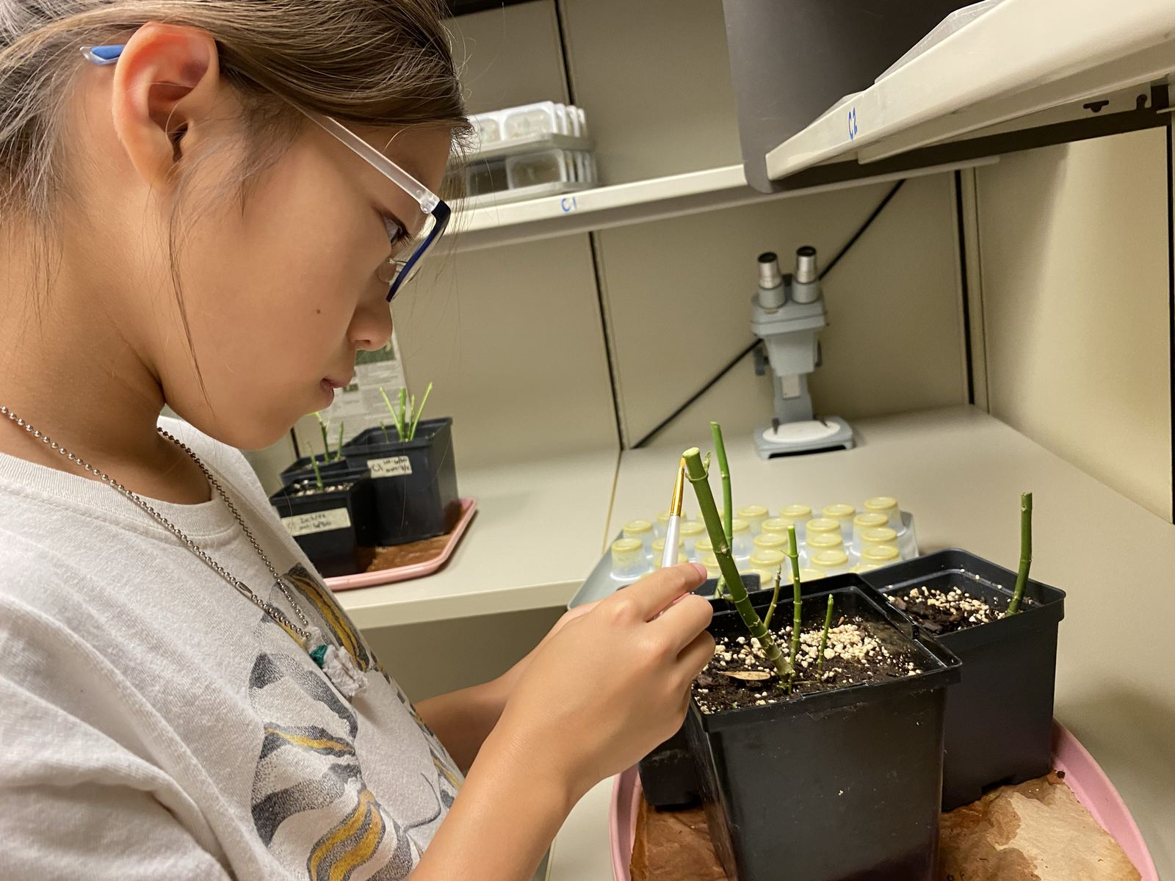
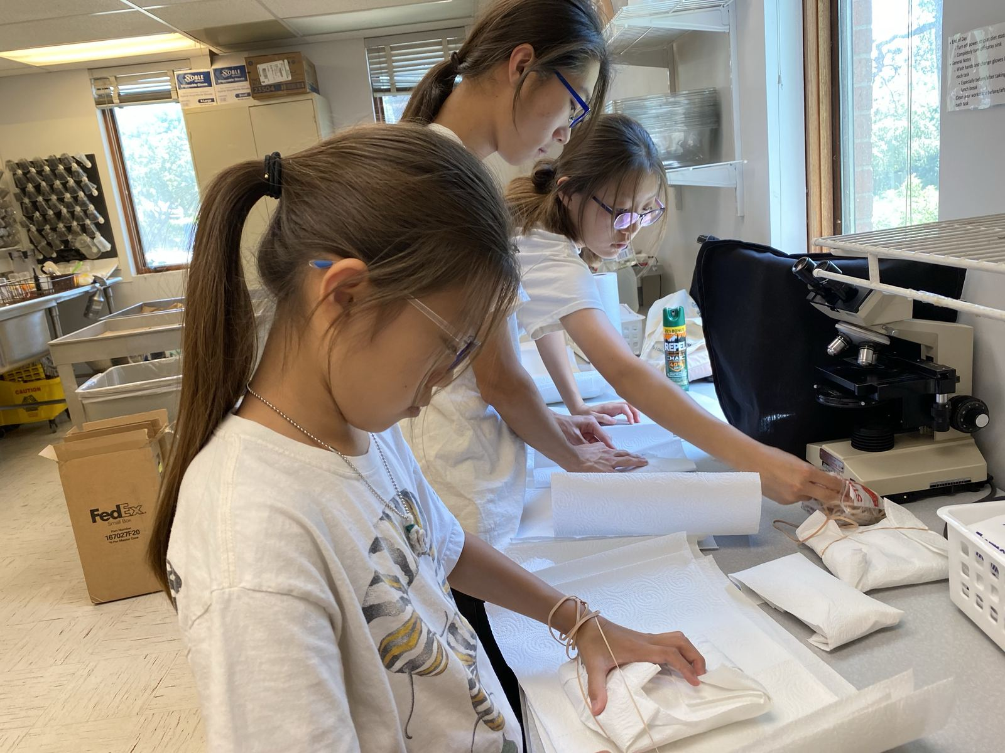
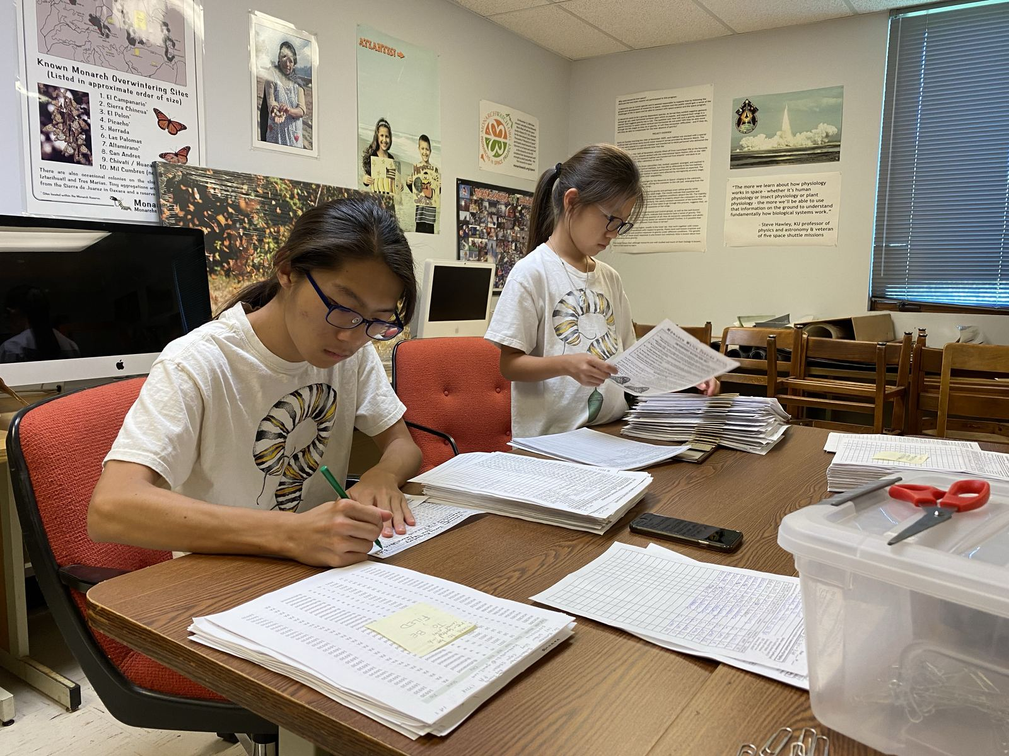
Monarch Butterfly Project
by Esther Kong

Slide 2
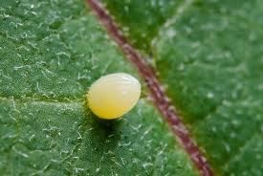
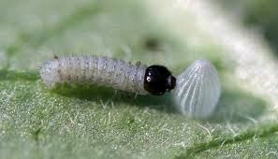
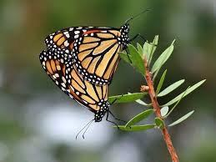
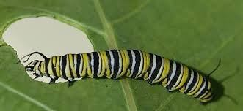
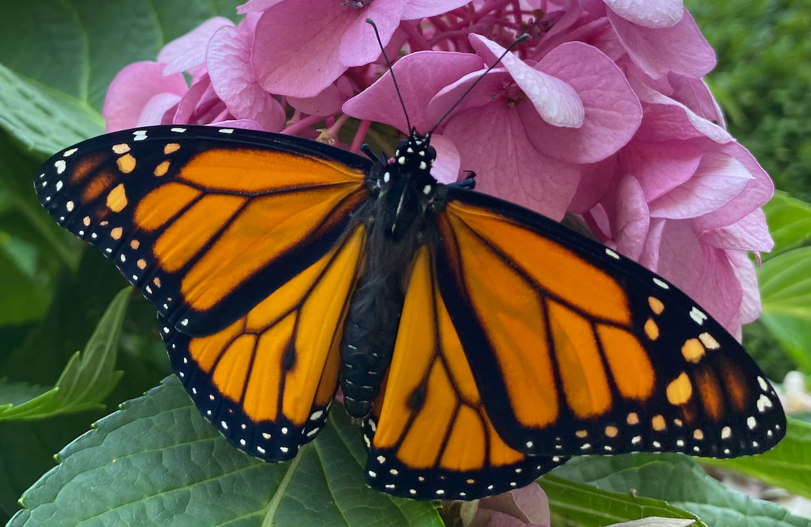
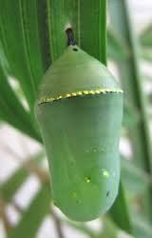
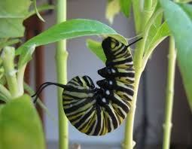
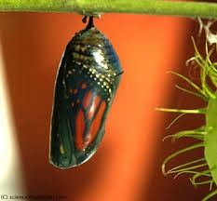
Life Cycle
Life Cycle

Slide 3
Monarch Eggs
The monarch butterfly lay eggs on milkweed because the caterpillar only eats milkweed!
A female Monarch can lay about 300 eggs but she lays one egg at a time.
Monarchs usually lay the eggs on the bottom of the leaves and it takes 3-4 days for eggs to hatch.

Slide 4
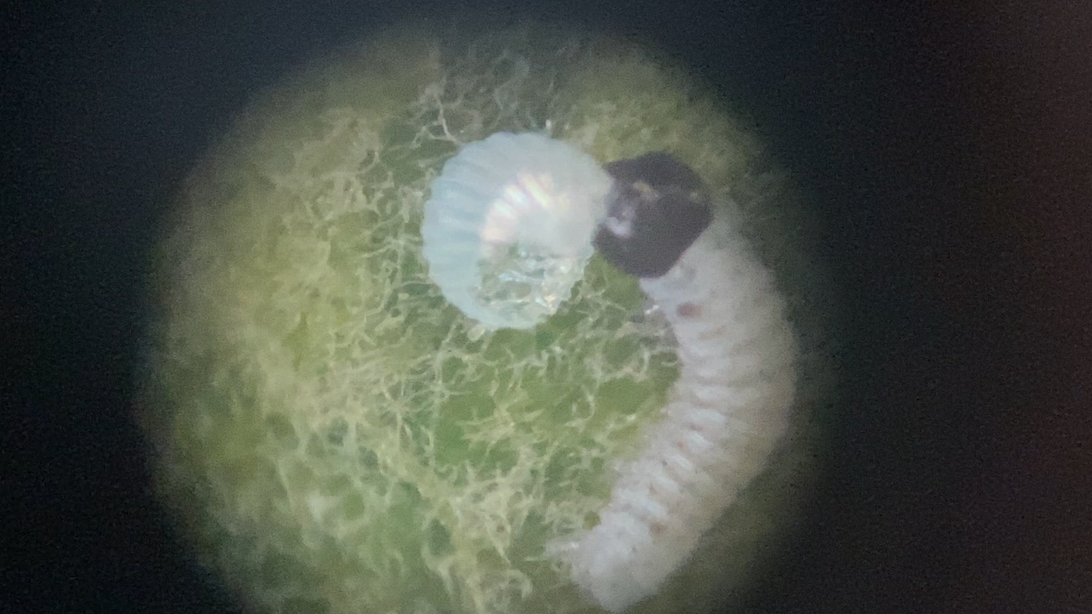
Monarch caterpillar eating eggshell

Slide 5
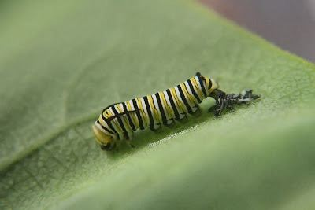
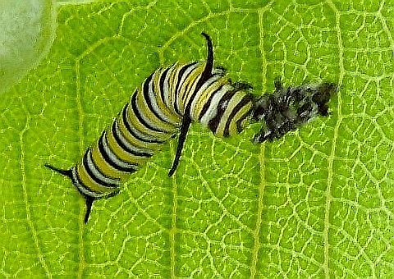
Caterpillar
When the caterpillar has become too large for its skin, it molts or sheds its skin.
The intervals between molts are called instars.
Monarchs go through five instars.

Slide 6
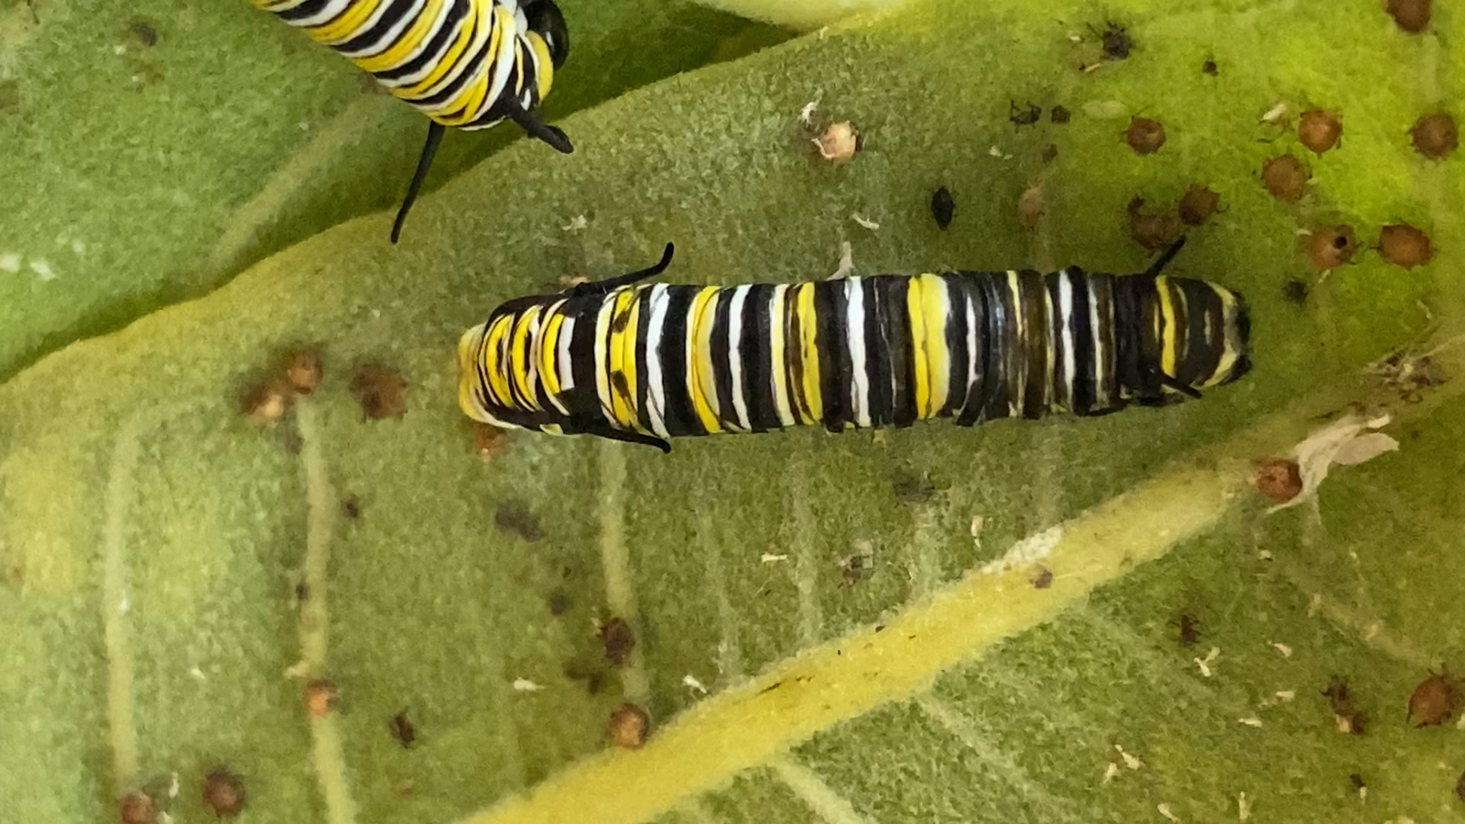
Monarch caterpillar
Monarch caterpillar
sheds its skin

Slide 7
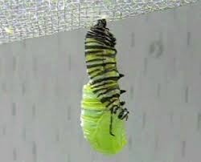
Chrysalis
Caterpillar turns into a J shape and takes about a day for it to turn into a chrysalis.

Slide 8
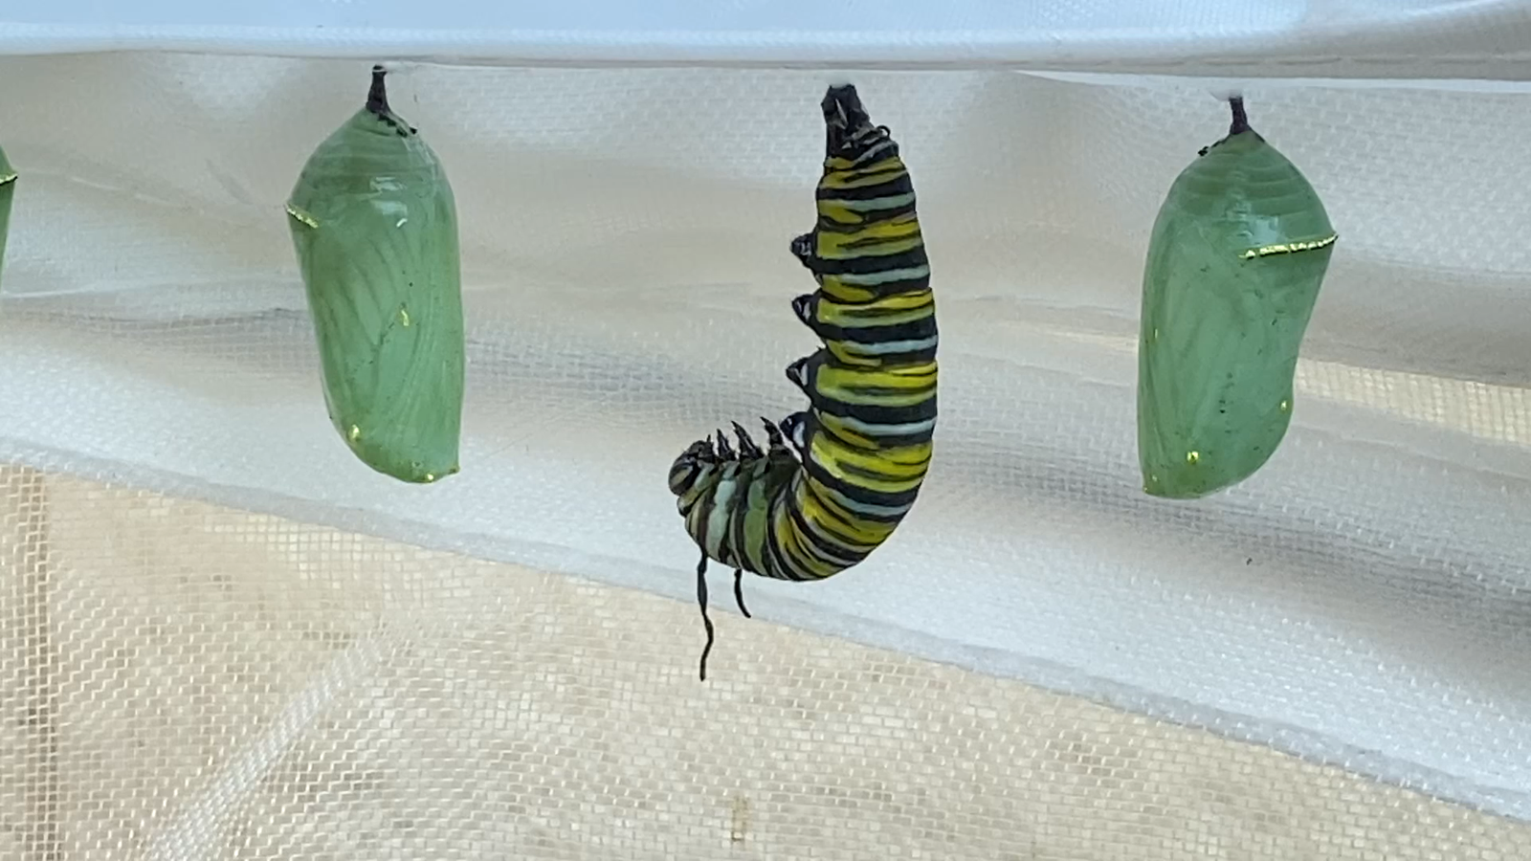
Chrysalis caterpillar
Monarch caterpillar turns into chrysalis

Slide 9
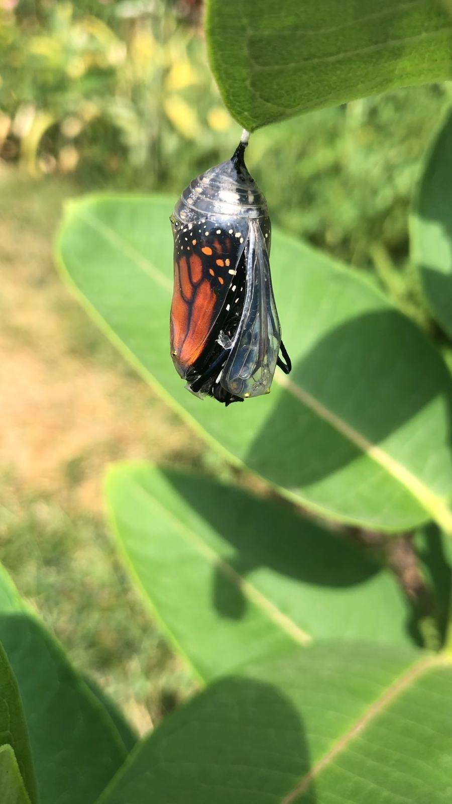
Monarch butterfly
2 weeks later
Chrysalis turns black with orange
Monarch butterfly coming out of chrysalis

Slide 10
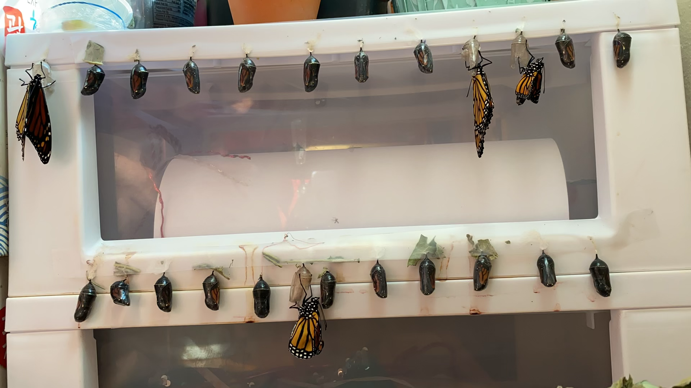
Lots of them
Lots of them!

Slide 11
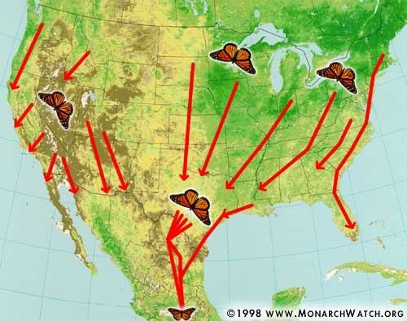
Migration
In the fall, monarch butterflies migrate to Mexico, Florida and California to hibernate.
They fly up to 3000 miles, travel 25 miles per day and live 6-8 months.
Migrating monarchs will not mate or lay eggs until spring.
They come back north in the spring. They lay eggs, new butterflies will lay eggs and move north all the way up to Canada.

Slide 12
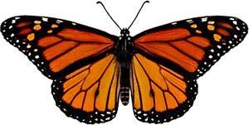
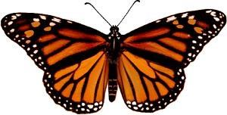
Butterfly
Male
Female
If it’s a male it has dots on the bottom of it’s wings.
If it’s a female it doesn’t have any dots.

Slide 13
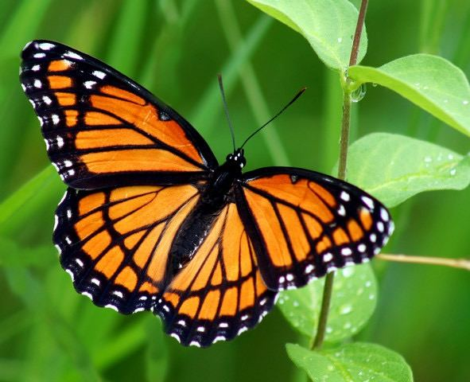
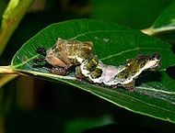
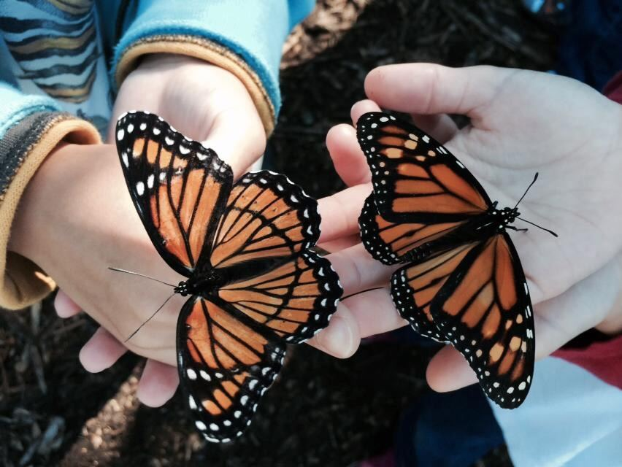
Monarch vs Viceroy
The viceroy looks like a monarch but it is just a copy of the monarch.
It is called mimicry.
If you see the black line on the hind wings, it is Viceroy.
They eat willow, cottonwood.

Slide 14

Save Monarchs
Monarch populations are declining because people are destroying monarch habitats and building farms and cities instead.
PLANT MILKWEED!
You can get milkweed from Monarch Watch during spring open house.

Slide 15
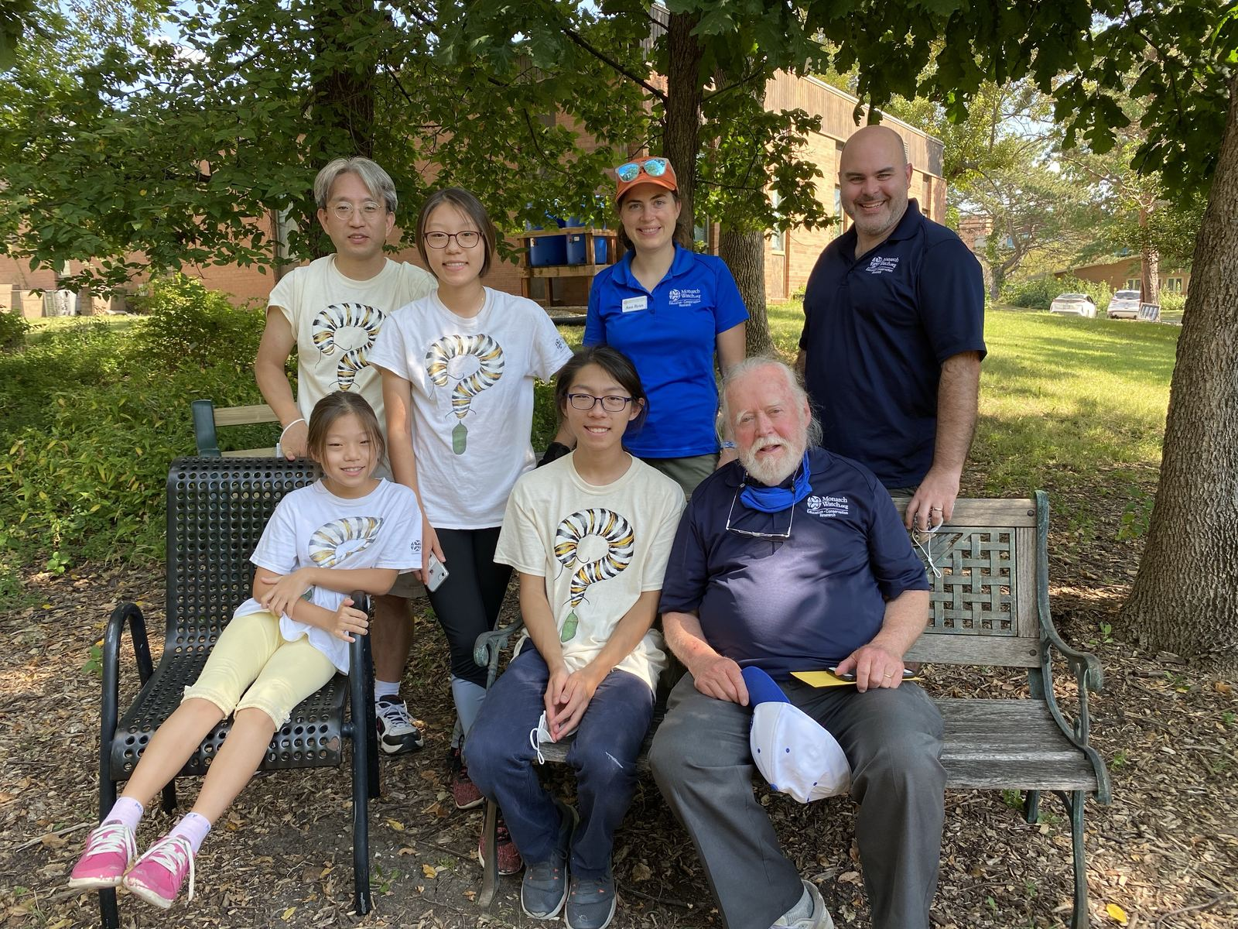
Monarch Watch
Monarch Watch is an organization that study Monarchs at KU.
People tag migrating monarchs so Monarch Watch can learn more about Monarchs.
Monarch Watch 30th year Celebration events
Lawrence Public Library : 2-3:30 pm, Saturday, September 3
Baker Wetlands Discovery Center Tagging event : 8-12 pm, Saturday, September 17
KU Natural History Museum : 12-1:30pm, Sunday, September 18

Slide 16
References
Monarch Watch - Ann Ryan, Chip Taylor
www.monarchwatch.com
Monarch Watch App

Slide 17
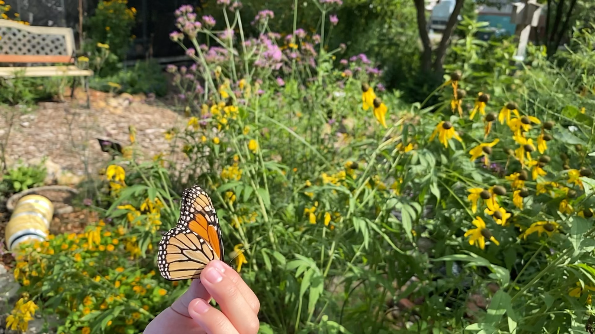
Butterfly in garden

Slide 18

How to catch a monarch
Notes:
Hi, I’m Casey from Monarch Watch and I’m going to show you how you can catch a butterfly. To catch a butterfly, you will want to sneak up, behind and below your net. Move very slowly so it does not become startled. And when you are about a foot away, you want to make a quick swooping motion and flip over the net so that the butterfly cannot escape.
Once you’ve caught your butterfly, you’ll want to keep your net like this so that the butterfly cannot escape through the opening. Now to actually pull out the butterfly you want to gently grab the butterfly from the outside while you reach your other hand in and grab it as well. Now you will want to grab the butterfly from either its thorax or the edge of its front wing and you can gently pull it out, just like that.
[music playing]

